Slide 1

IS1201: Programming & Problem Solving
5. Conditions and Loops
Viraj Welgama

Slide 2
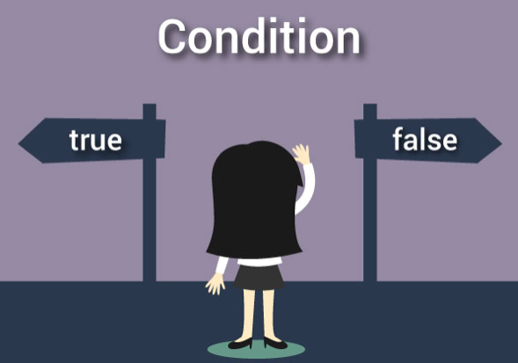
Conditions
In programming, decision making is used to specify the order in which statements are executed.

Slide 3
C Ternary Operator (?:)
The conditional operator works as follows:
The first expression conditionalExpression is evaluated first. This expression evaluates to 1 if it's true and evaluates to 0 if it's false.
If conditionalExpression is true, expression1 is evaluated.
If conditionalExpression is false, expression2 is evaluated.
A conditional operator is a ternary operator, that is, it works on 3 operands.

Slide 4
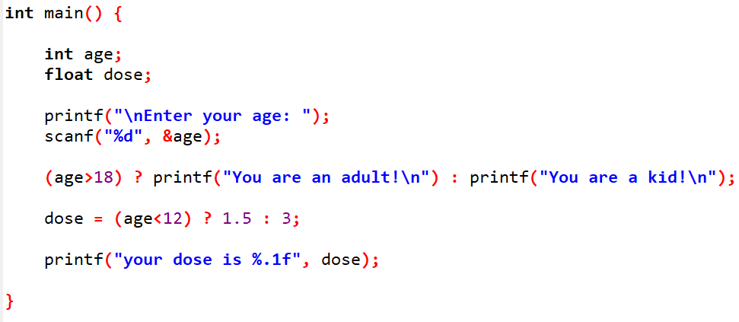
Example: Ternary Operator

Slide 5
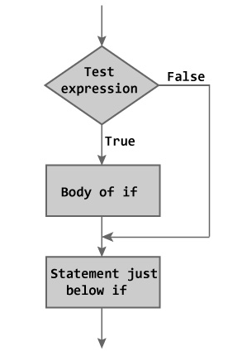
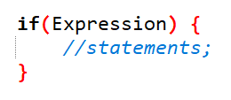
if Statement
The if statement evaluates the expression inside the parenthesis.
If the test expression is evaluated to true (nonzero), statements inside the body of if is executed.
If the test expression is evaluated to false (0), statements inside the body of if is skipped from execution.

Slide 6
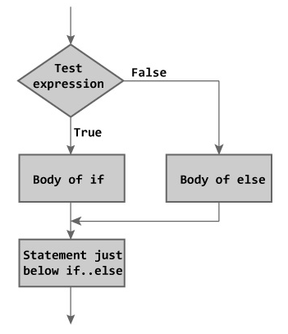
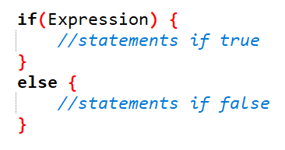
if…else Statement
If test expression is true, codes inside the body of if statement is executed and, codes inside the body of else statement is skipped.
If test expression is false, codes inside the body of else statement is executed and, codes inside the body of if statement is skipped.

Slide 7
Odd & Even Numbers

Slide 8
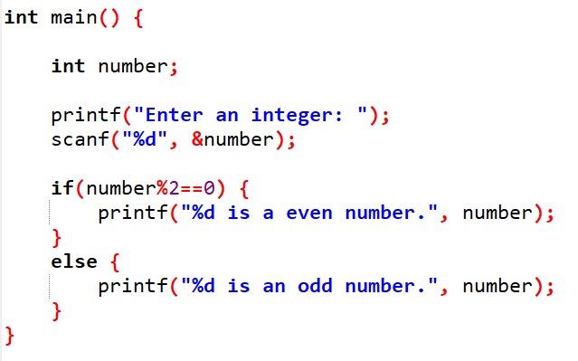
Odd & Even Numbers

Slide 9
Odd & Even Numbers
What if you need to print done! after printing the massage?

Slide 10
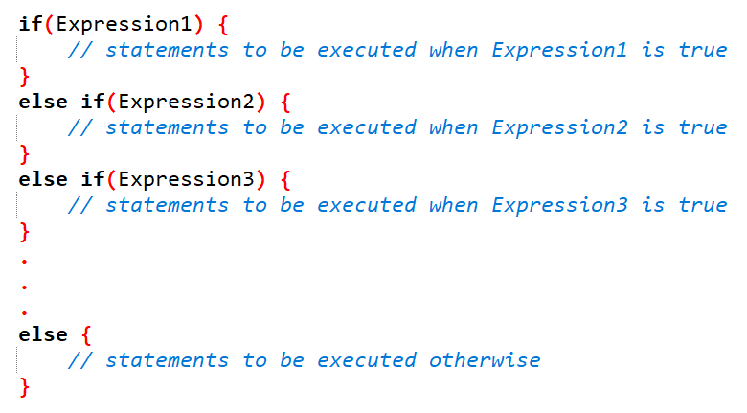
else if…

Slide 11
Example: Grades
Write a program to give the grade when you enter your mark of a subject.
The grade of the mark is defined as follows.
00 – 24: E
25 – 34: D
35 – 49: C
50 – 69: B
70 – 100: A

Slide 12
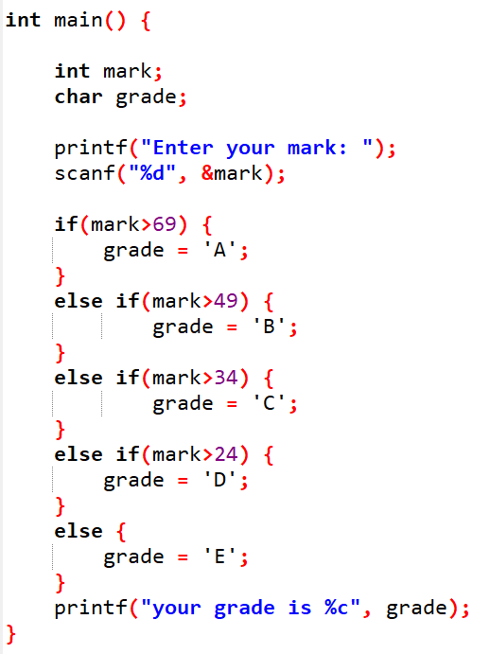
Example: Grades

Slide 13
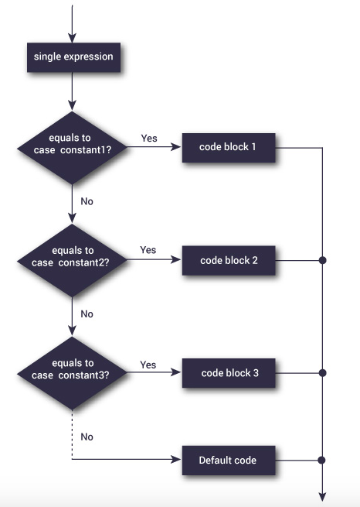

case Statement
The if..else..if ladder allows you to execute a block code among many alternatives.
If you are checking on the value of a single variable in if...else...if, it is better to use switch statement.
The switch statement is often faster than multiple if...else.

Slide 14
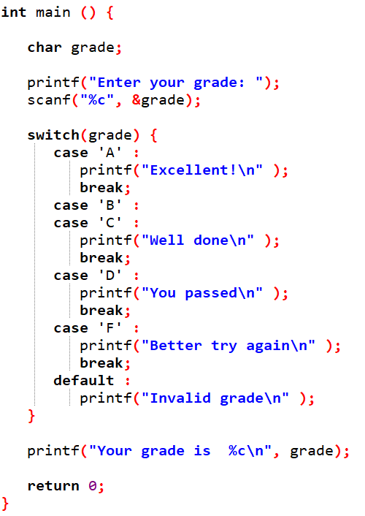
Example:

Slide 15
Rules of case statement
The expression used in a switch statement must have an integral or enumerated type, or be of a class type in which the class has a single conversion function to an integral or enumerated type.
You can have any number of case statements within a switch. Each case is followed by the value to be compared to and a colon.
The constant-expression for a case must be the same data type as the variable in the switch, and it must be a constant or a literal.
When the variable being switched on is equal to a case, the statements following that case will execute until a break statement is reached.
When a break statement is reached, the switch terminates, and the flow of control jumps to the next line following the switch statement.
Not every case needs to contain a break. If no break appears, the flow of control will fall through to subsequent cases until a break is reached.
A switch statement can have an optional default case, which must appear at the end of the switch. The default case can be used for performing a task when none of the cases is true. No break is needed in the default case.

Slide 16
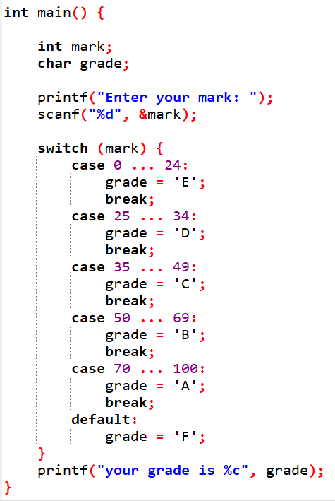
Example: Grades

Slide 17
Loops
Loops are used in programming to repeat a specific block of code.
There are three loops in C programming:
for loop
while loop
do...while loop

Slide 18
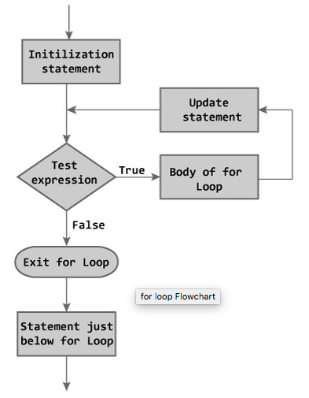
for Loop
The initialization statement is executed only once.
Then, the test expression is evaluated. If the test expression is false (0), the loop is terminated.
If the test expression is true (nonzero), codes inside the body of the loop is executed.
Then, the update statement is executed and update the variable.
This process repeats until the test expression is false.
The for loop is commonly used when the number of iterations is known.

Slide 19
Example: Finding Factors

Slide 20
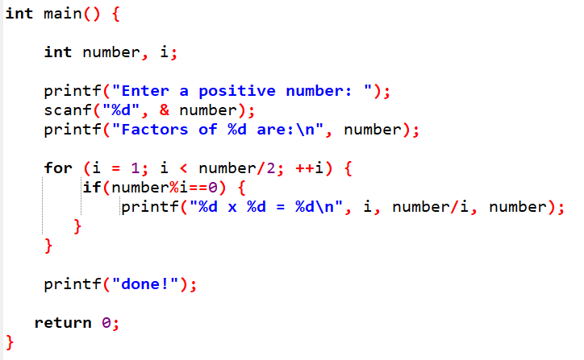
Example: Finding Factors

Slide 21
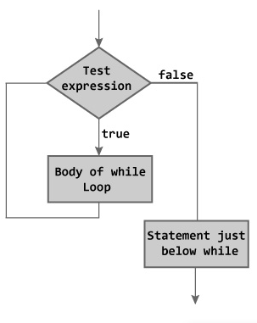
while Loop
The while loop evaluates the test expression.
If the test expression is true (nonzero), codes inside the body of while loop are executed
The test expression is evaluated again. The process goes on until the test expression is false.
When the test expression is false, the while loop is terminated.

Slide 22
Example: while
Finding factors of numbers till you feel enough!

Slide 23
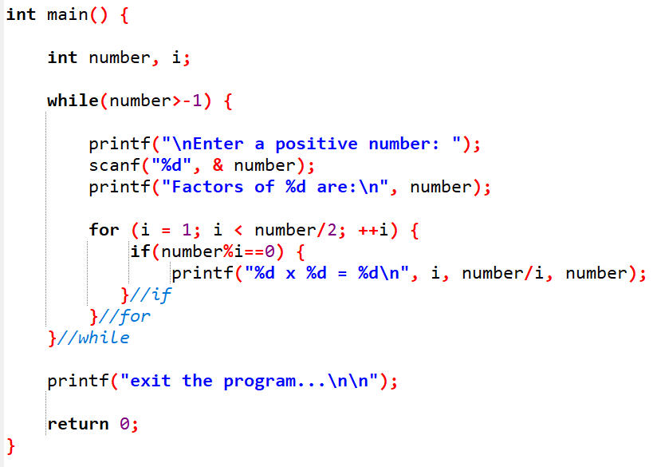
Example: while
Finding factors of numbers till you feel enough!

Slide 24
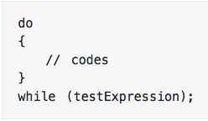
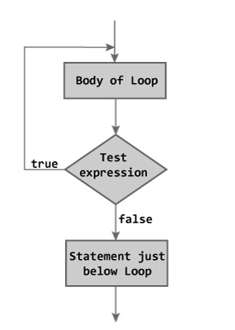
do...while Loop
The do...while loop is similar to the while loop with one important difference.
The body of do...while loop is executed once, before checking the test expression.
Hence, the do...while loop is executed at least once.

Slide 25
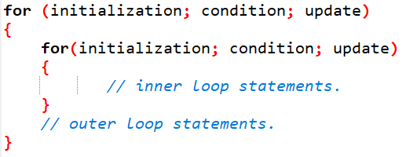
Nested Loops
Nesting of loops is the feature in C that allows the looping of statements inside another loop.
Any number of loops can be defined inside another loop, i.e., there is no restriction for defining any number of loops.
The nesting level can be defined at n times.
You can define any type of loop inside another loop;
for example, you can define 'while' loop inside a 'for' loop.

Slide 26
Example: Pyramids
Write a program to print the following pattern for given number of rows form the character given by the user.
Ex: if user enters 5 as no of rows and ‘*’ as the character, following pattern should be printed in the console.
*
**
***
****
*****

Slide 27
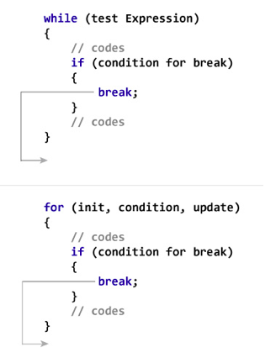
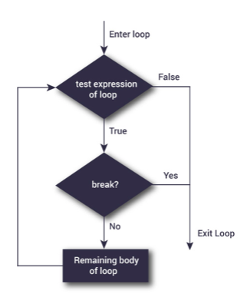
break
The break statement terminates the loop (for, while and do...while loop) immediately when it is encountered.
The break statement is used with decision making statement such as if...else.

Slide 28
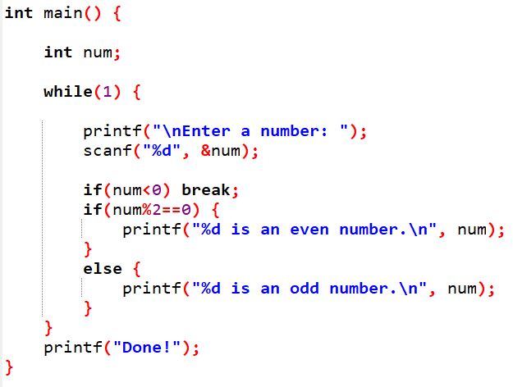
Example: break

Slide 29
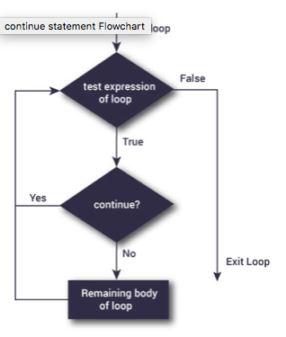
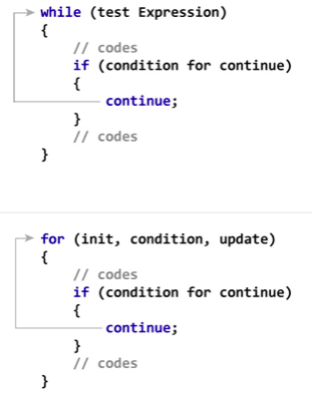
continue
The continue statement skips some statements inside the loop.
The continue statement is used with decision making statement such as if...else.

Slide 30
Example: continue
Write a program to print numbers divided by 5, but not 10 between 1-100.

Slide 31
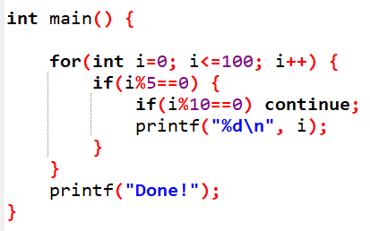
Example: continue
Write a program to print numbers divided by 5, but not 10 between 1-100.

Slide 32
Example: continue
Write a program to print numbers divided by 5, but not 10 between 1-100.
'for' loop initial declarations are only allowed in C99 or C11 mode
Notes:
Tools -> Compliter Options
Paste -std=c11

Slide 33
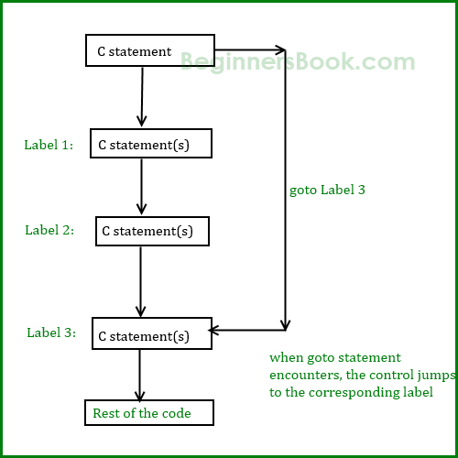
goto
The goto statement is used to alter the normal sequence of a C program.
When goto statement is encountered, control of the program jumps to label: and starts executing the code.
However, The goto statement is rarely used because it makes program confusing, less readable and complex.
Also, when this is used, the control of the program won’t be easy to trace, hence it makes testing and debugging difficult.

Slide 34
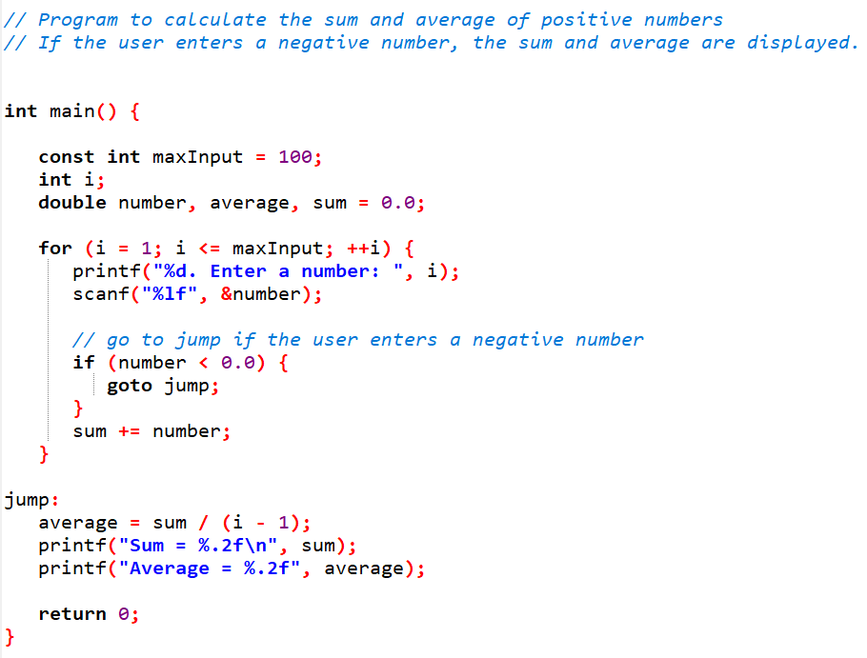
Example: goto

Slide 35
Problems
Write a program to take a positive integer (let say n) as an input from the user and calculate the sum of all integers up to n.
Write a program to determine the given number is prime number
Write a program to return the largest Integer from the given set of numbers.
Write a C Program to reverse a number

